Slide 1
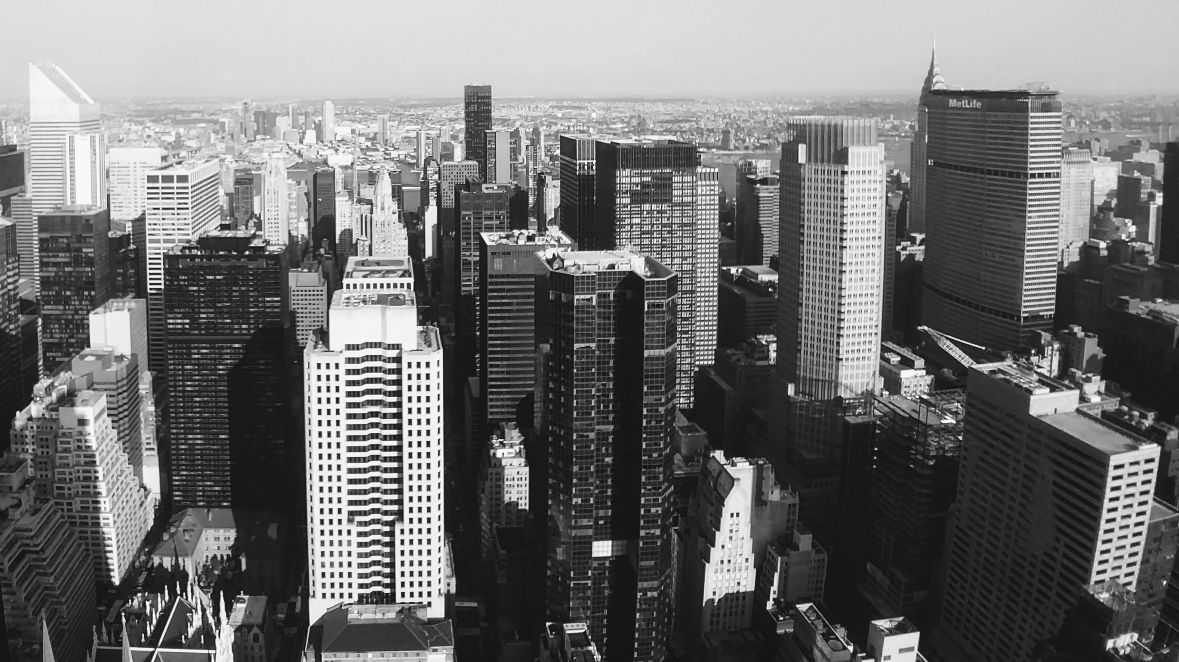
Slide 1
Predicting Customer Churn(Prototype)
Bank Dataset- Draft Slides

Slide 2
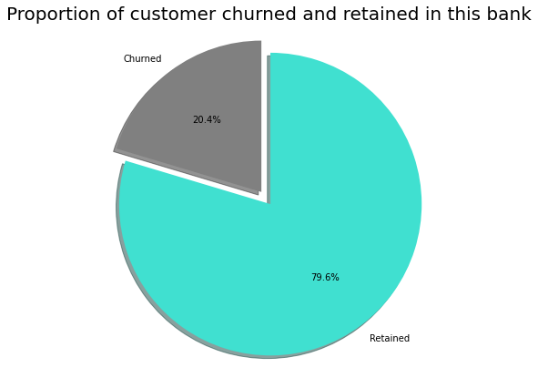
Slide 6
FACTS AND CHURN PROBLEM
11% customer attrition rate in banks.
20-25% annual churn rates on new customers in the first year thereby impacting the cost of acquisition. Some large banks incur acquisition cost of $1500 -$ 2000 per new customer.
The goal of this model is to predict customer churn in a bank.
This problem is illustrated using a dataset from Kaggle. The dataset comprises of 13 variables and 10,000 records including identifiers like customer id and surname.
Independent numeric variables: CreditScore, Age, Tenure, Balance, NumOfProducts, EstimatedSalary
Independent categorical variables: Geography, Gender, HasCrCard, IsActiveMember
Dependent variable : Exited (0, 1)
2
Notes:
This dataset does not have dates and data is limited.
These numbers are based on research
-https://tearsheet.co/data/why-customer-acquisition-is-so-difficult-for-financial-startups/#:~:text=Customer%20acquisition%20is%20expensive.,helps%20advisors%20manage%20portfolio%20risk.
https://thefinancialbrand.com/68371/banking-customer-acquisition-attrition-growth-strategy/#:~:text=According%20to%20Accenture%2C%20attrition%20rates,days%20after%20opening%20their%20accounts.
https://www.kaggle.com/kmalit/bank-customer-churn-prediction

Slide 3
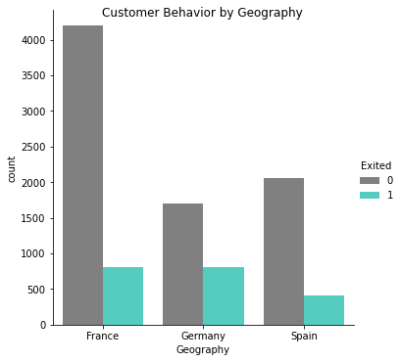
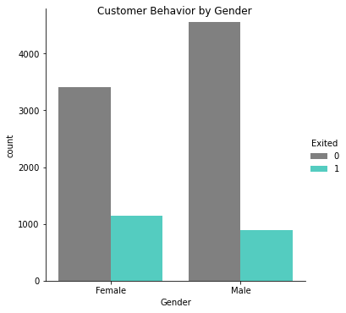
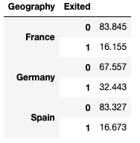
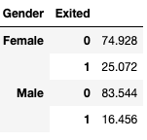

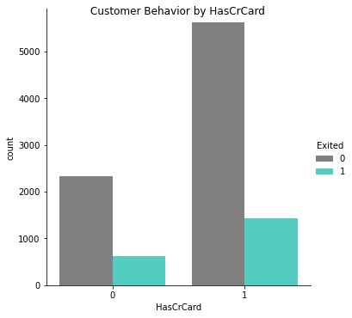
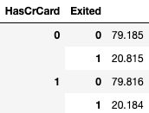
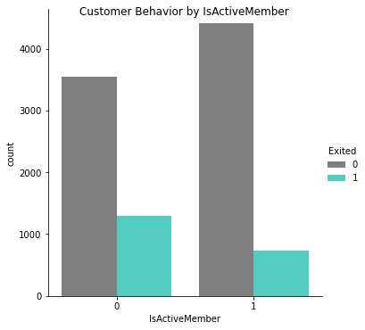
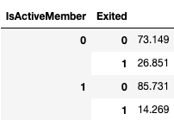
Slide 2
PRESENT CHURN SITUATION IN THE BANK
Mutual Information Score
3

Slide 4
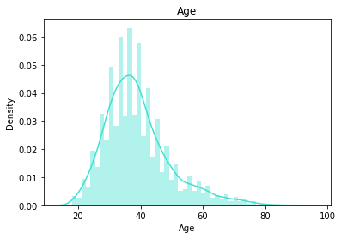
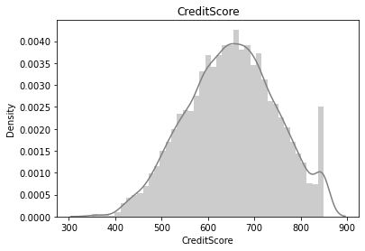
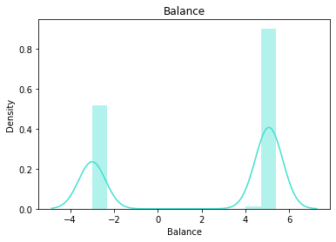
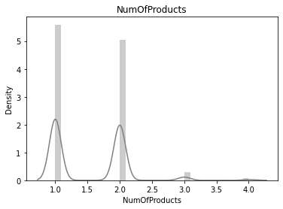
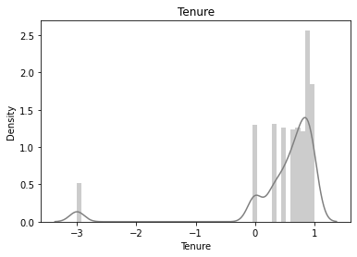
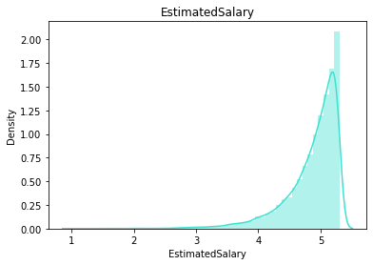
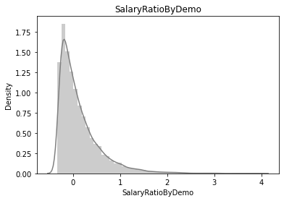
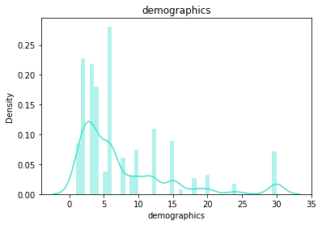
Slide 2
PRESENT CHURN SITUATION IN THE BANK
4

Slide 5
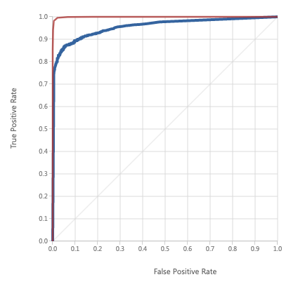
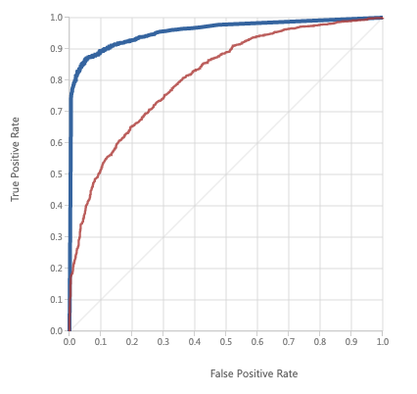
Slide 2
COMPARISON BETWEEN DIFFERENT MACHINE LEARNING ALGORITHMS
BOOSTED DECISION TREE VS DECISION FOREST
 | BOOSTED DECISION TREE | DECISION FOREST | LOGISTIC REGRESSION
Parameters | Max No. of leaves per tree: 20 Min no. of samples per leaf node: 10 Learning Rate:0.2 No. of trees constructed :1000 | No. of decision trees:8 Max depth of the decision trees:32 No. of random splits per node:128 Min no. of samples per leaf node:1 | Optimization tolerance:1E-07 L1 regularization : 1 L2 regularization : 1 Memory size for L-BGFS:20
Score | Accuracy: 0.901 Precision: 0.922 Recall: 0.878 F1 Score: 0.90 AUC:0.959 | Accuracy: 0.988 Precision: 0.995 Recall: 0.981 F1 Score: 0.988 AUC:099 | Accuracy: 0.722 Precision: 0.715 Recall: 0.745 F1 Score: 0.730 AUC:0.812
Training Time | 8 secs | 9 secs | 7 secs
Result | SELECTED | NOT SELECTED | NOT SELECTED
BOOSTED DECISION TREE VS LOGISTIC REG
5
4
4

Slide 6
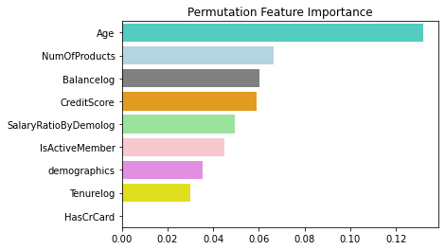
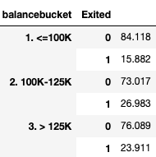
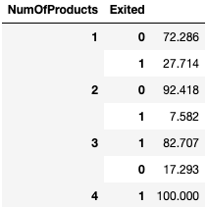
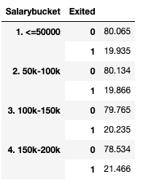
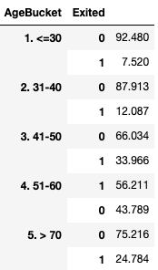
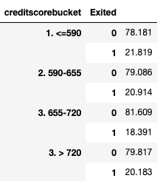
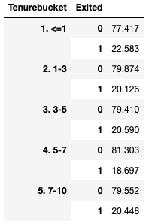
Slide 2
FEATURE IMPORTANCE AND PRESCRIPTION
6
4

Slide 7
Slide 6
RECOMMENDATIONS
Protocol to reduce churn in the bank (Prioritize on the following group)
Age groups : 51-60
Num of products held : 4 and above
Bank Balance of $ 100k-$150k
Female customers from Germany
Credit score, salary and tenure needs more data to understand how it impacts the breakdown here
Summarized points
Monitoring customer lifetime value by geography and age-groups
Generating customer satisfaction scores and coming up with customer feedback programs
Improving customer experience and providing wow moments
Checking the customer centricity that includes :
Keeping a tab on fee-hikes
Offering better rates
Increasing the branch locations
24*7 customer service
Breadth of product offering and product bundles
Improving the quality of customer technology like the bank app
2
Notes:
This dataset does not have dates and data is limited.
These numbers are based on research
-https://tearsheet.co/data/why-customer-acquisition-is-so-difficult-for-financial-startups/#:~:text=Customer%20acquisition%20is%20expensive.,helps%20advisors%20manage%20portfolio%20risk.
https://thefinancialbrand.com/68371/banking-customer-acquisition-attrition-growth-strategy/#:~:text=According%20to%20Accenture%2C%20attrition%20rates,days%20after%20opening%20their%20accounts.
https://www.kaggle.com/kmalit/bank-customer-churn-prediction

Slide 8
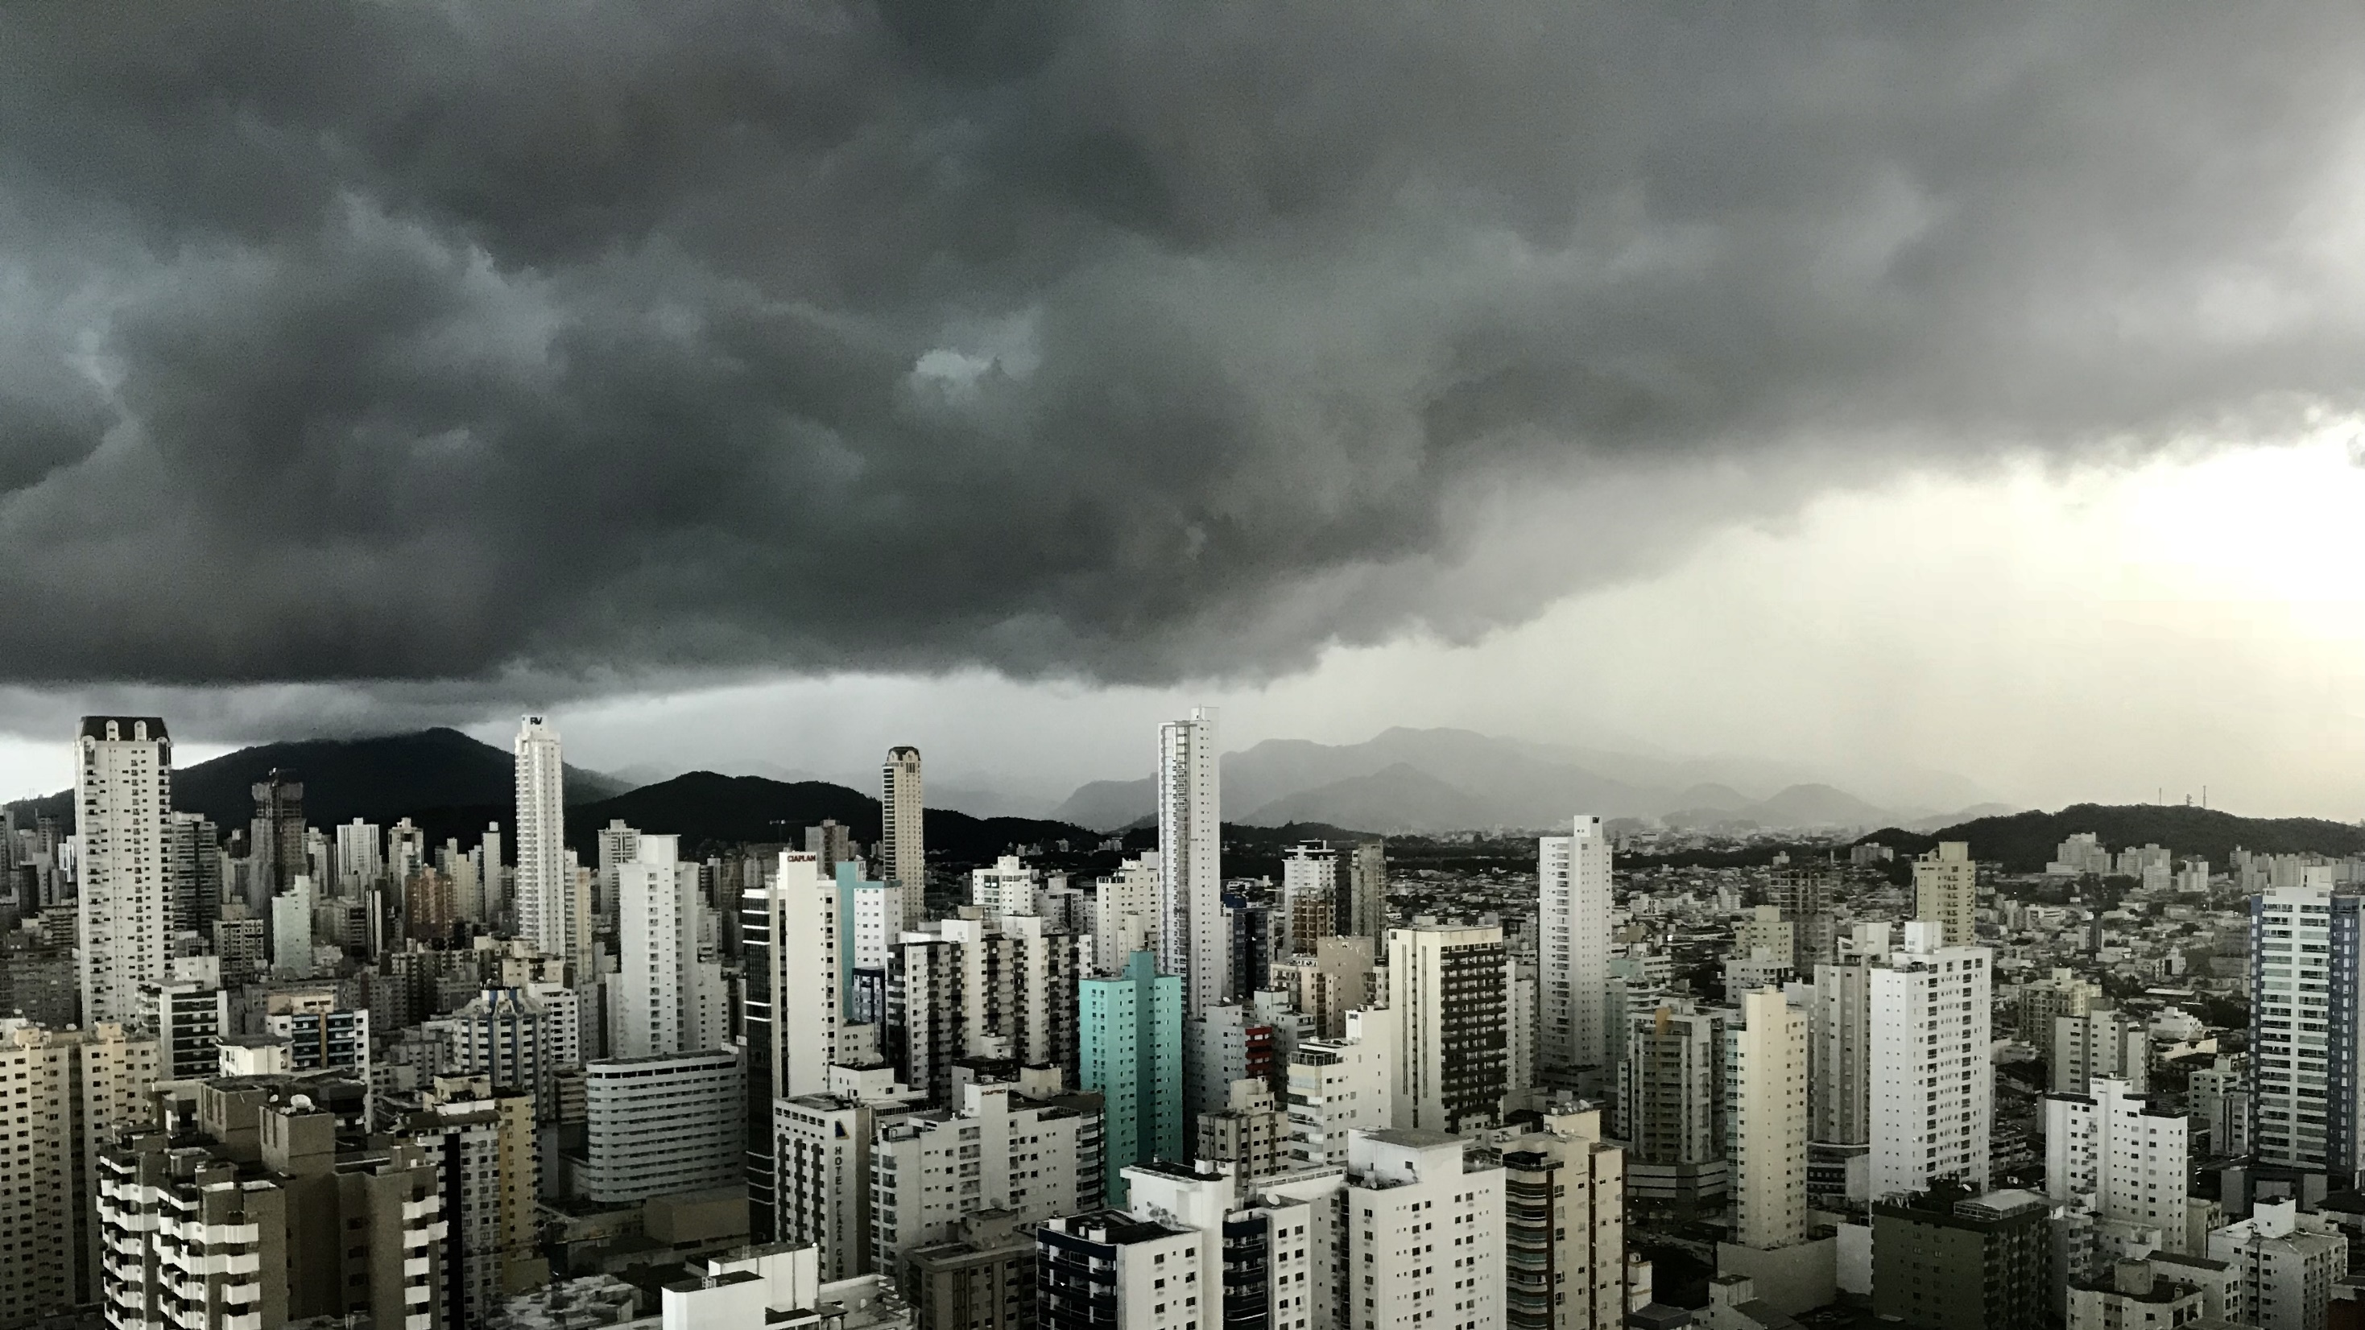
Slide 11
THANK YOU

